Slide 1





Walmart USA
Data Analysis
Insights from Transactional and Demographic Data
By Shivanshu Verma

Slide 2
Walmart: Where America Shops
Founded in 1962, Walmart has grown into the world’s largest retailer, trusted by millions of Americans for everyday essentials and unbeatable prices. With over 10,500+ stores worldwide and a strong e-commerce presence, Walmart blends affordability, convenience, and innovation. Its mission is simple yet powerful: Save money. Live better. Whether it’s groceries, electronics, or household goods, Walmart is the go-to destination for families across the nation.

Slide 3
Executive Summary
Billions in Sales, Thousands of Stories
98,660 transactions analyzed
5.2 billion USD in total profit
4.97 million products sold
Data spans 20 store locations across the U.S.
Focus on customer demographics, store performance, and key trends

Slide 4
The Blueprint Behind the Billions
Total Transactions: 98,660
Attributes: 18
Including: Transaction ID, Store, Product, Sales & Cost, Profit, Loss, Customer Age & Gender, Payment Method, Customer Segment, Seasonality, Order Method, Geography
Data spans multiple years of Walmart sales

Slide 5
The Metrics that Matters
Total Profit: $5.2 Billion
Average Profit per Transaction: $5,271
Total Products Sold: 4.97 Million
Number of States having Walmart: 50
Top Store Profit: ~$300 Million

Slide 6
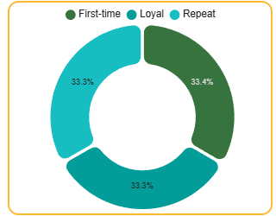
Three Faces of a Walmart Shopper
First-time: New visitors, influenced by promos
Repeat: Return customers, not fully loyal yet
Loyal: Frequent, high-value buyers
All three segments contribute evenly to overall profit, indicating strong acquisition and retention.

Slide 7
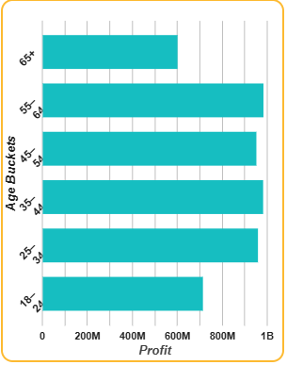
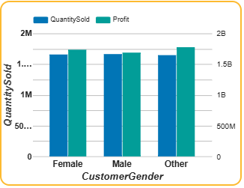
Who’s Buying and When
Top Profit Age Group: Customers aged 55–64 drive the most profit, likely due to higher spending power.
Largest Customer Base: Most shoppers fall in the 35–44 age group.
Gender Insights: Sales are nearly equal across male, female, and other genders, showing Walmart’s broad and inclusive appeal.

Slide 8
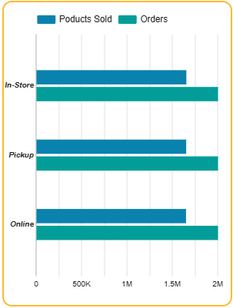
How They Pay and Shop
Top Payment Methods: Walmart Pay and Credit Card
Why Walmart Pay? Contactless, secure, digital receipts, rewards integration
Most Profitable Order Method: In-Store purchases outperform online channels

Slide 9
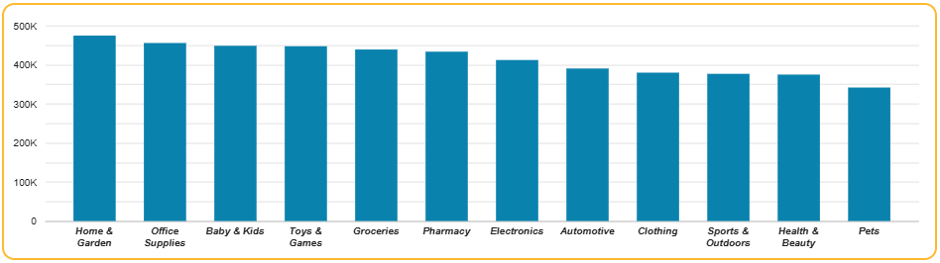
Product Power Players
Top-selling categories include: Home & Garden, Office Supplies, Toys & Games, Groceries.
These reflect both essential needs and seasonal buying patterns.

Slide 10
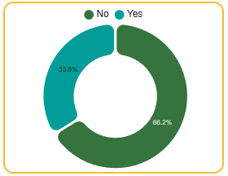
Riding the Seasonal Wave
Over 66% of profit comes from seasonal sales
Major peaks during holidays and promotional events
Seasonal insights help with inventory planning, staffing, and forecasting
Seasonality v/s Profit

Slide 11
Strategic Insights
Most profit came from customers aged 55–64, despite them not being the largest group.
The 35–44 age group had the highest number of customers overall.
Sales were evenly split across male and female customers, with notable purchases from other genders too.
Seasonal transactions accounted for over 66% of total profit, highlighting the impact of holidays and events.
Walmart Pay and Credit Cards were the most used payment methods.
In-store purchases contributed more profit than other order methods.
Home & Garden, Office Supplies, and Groceries were the most purchased categories.
All customer segments—First-time, Repeat, and Loyal—contributed fairly equally to profit.

Slide 12
Quick Wins For Bigger Gains
Customers aged 55 to 64 are the most profitable, so targeted promotions could further increase their spending. The 35 to 44 age group is the largest customer base, and keeping them engaged with personalized offers is key to maintaining strong sales. Over 66% of Walmart's profit comes from seasonal sales, so early planning and focused promotions during peak times can maximize this revenue. Walmart Pay and Credit Cards are the most used payment methods, and offering additional incentives like rewards or exclusive discounts could increase adoption. Sales are nearly even across genders, with a noticeable portion from "other" identities. Inclusive messaging and product offerings could strengthen brand loyalty. In-store purchases are the most profitable, and improving the in-store experience through faster checkout and better service can drive even more sales. Categories like Groceries, Home & Garden, and Toys perform the best, so maintaining strong marketing and stocking efforts for these products is crucial.

Slide 13
Growth Strategies In Focus
Target high-profit age groups (55-64) with tailored promotions.
Engage the largest customer base (35-44) with personalized offers.
Maximize seasonal sales through early planning and targeted promotions.
Improve the in-store experience to boost profitability.
Strengthen inclusivity with gender-balanced marketing.
Prioritize top-selling categories (Groceries, Home & Garden, Toys).

Slide 14
And That's a wrap!
Thanks for sticking around!!!
Got any Questions??? Drop me a mail! :
shivanshuverma210901@gmail.com
"Success is not the key to happiness. Happiness is the key to success... and coffee." – Albert Schweitzer

